Slide 1


How to Succeed in Capstone
Arushri Swarup
October 5, 2016

Slide 2
When you’re stuck…
Constant Communication
Ask Questions
Productive Meetings
Take Breaks…
With Client, Prof, TA
To split up work

Slide 3
My Project
Developing Tools for Endoscopic Ear Surgery
Client: Dr. Adrian James, ENT SickKids
Problem: Endoscopic ear surgery is single-handed
In ear drum reconstruction, a graft is placed on the ear drum. Rosen needle used to impale the graft but hard to take out.
Solution: tool that combines a two-handed maneuver
Designed a ‘graft pusher mechanism’
https://i.ytimg.com/vi/gVSerAvym7A/hqdefault.jpg

Slide 4
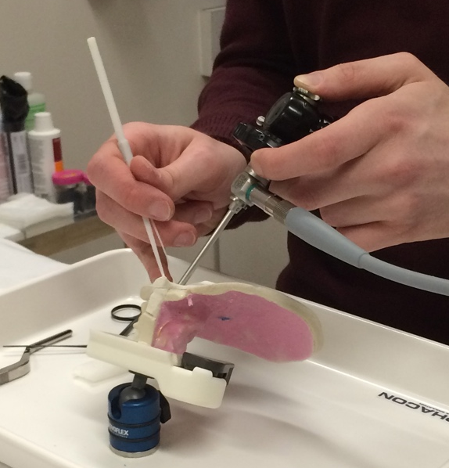
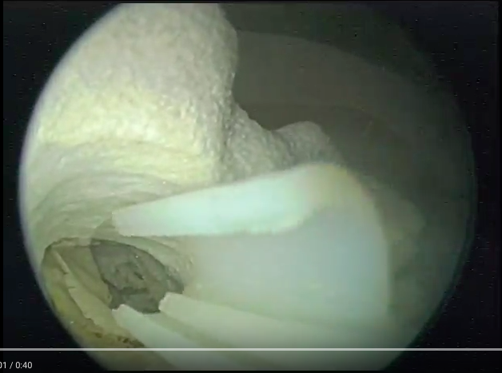
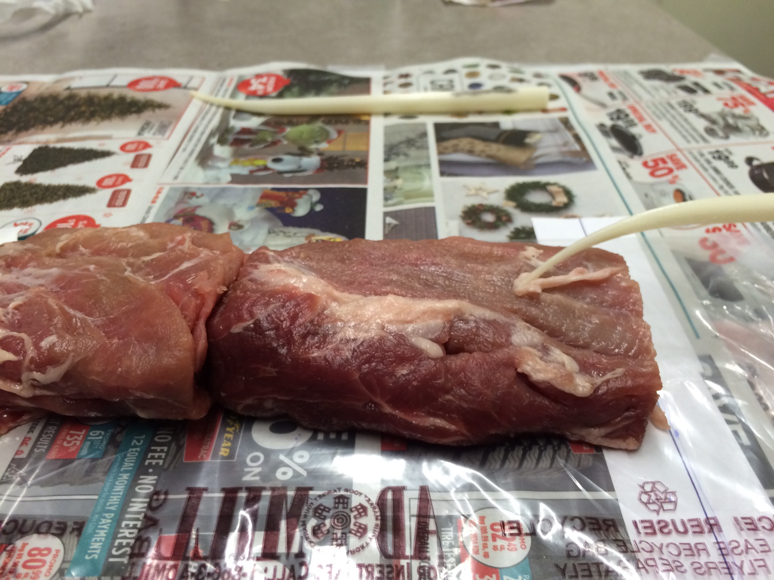
Background Research
Prototype Development
Testing
Design for Manufacturing
X
Notes:
Background - Surgical context, existing tools, developed CAD for tools and ear.
Prototype Development – large scale models, tip design (curvature and surface), graft pusher
Testing – meat, 3D ear model
Did not have time&money to re-iterate through the design cycle to finalize and refine the design
Next step after final design would be design for manufacturing and sterilizability
By the end we were in this cycle

Slide 5
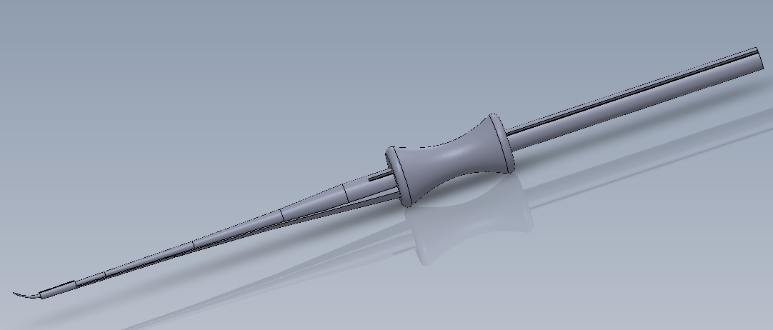
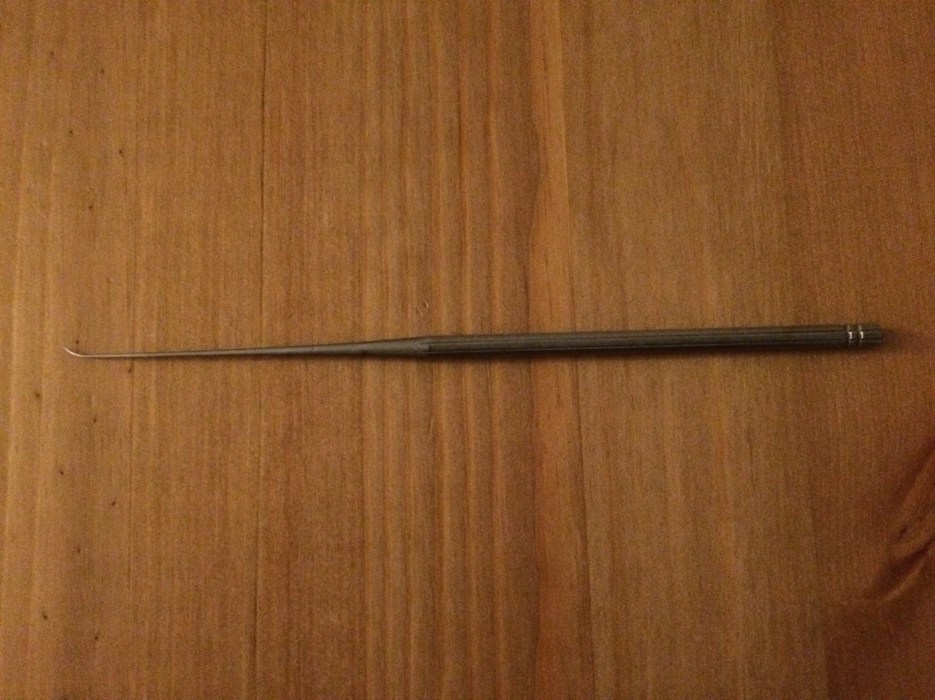
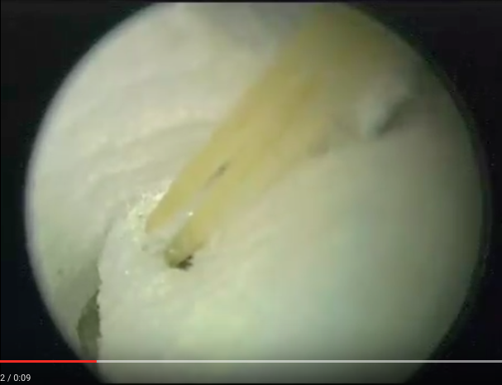
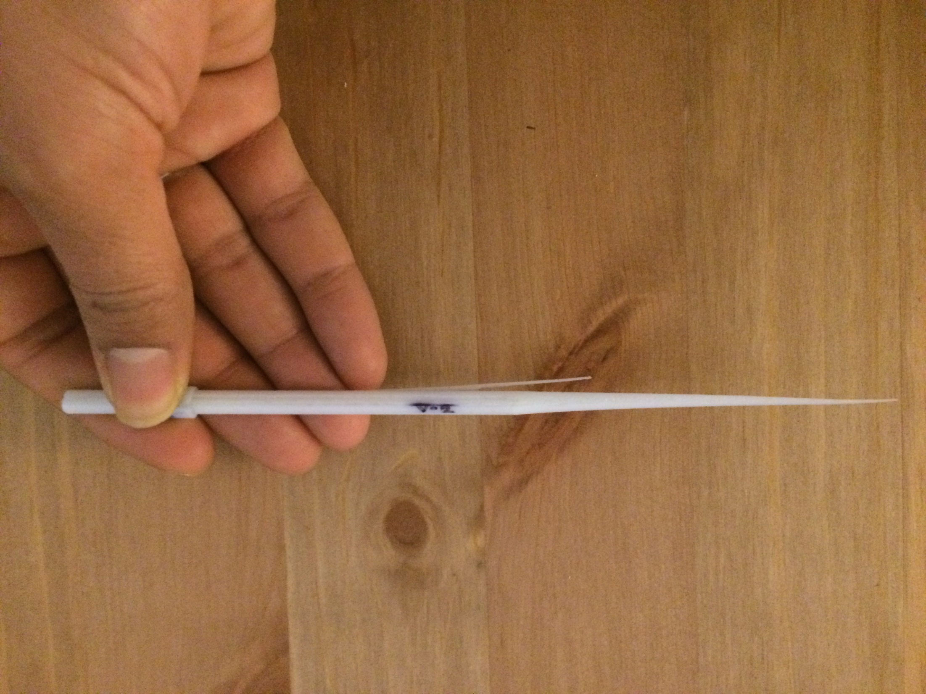
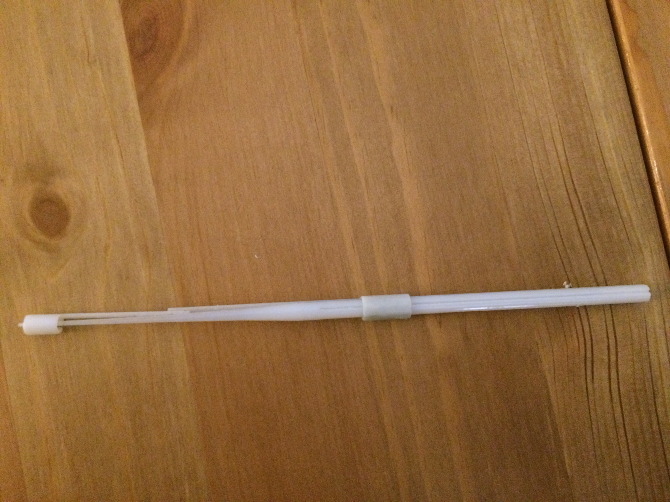
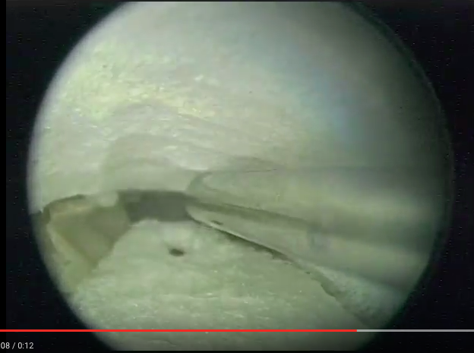
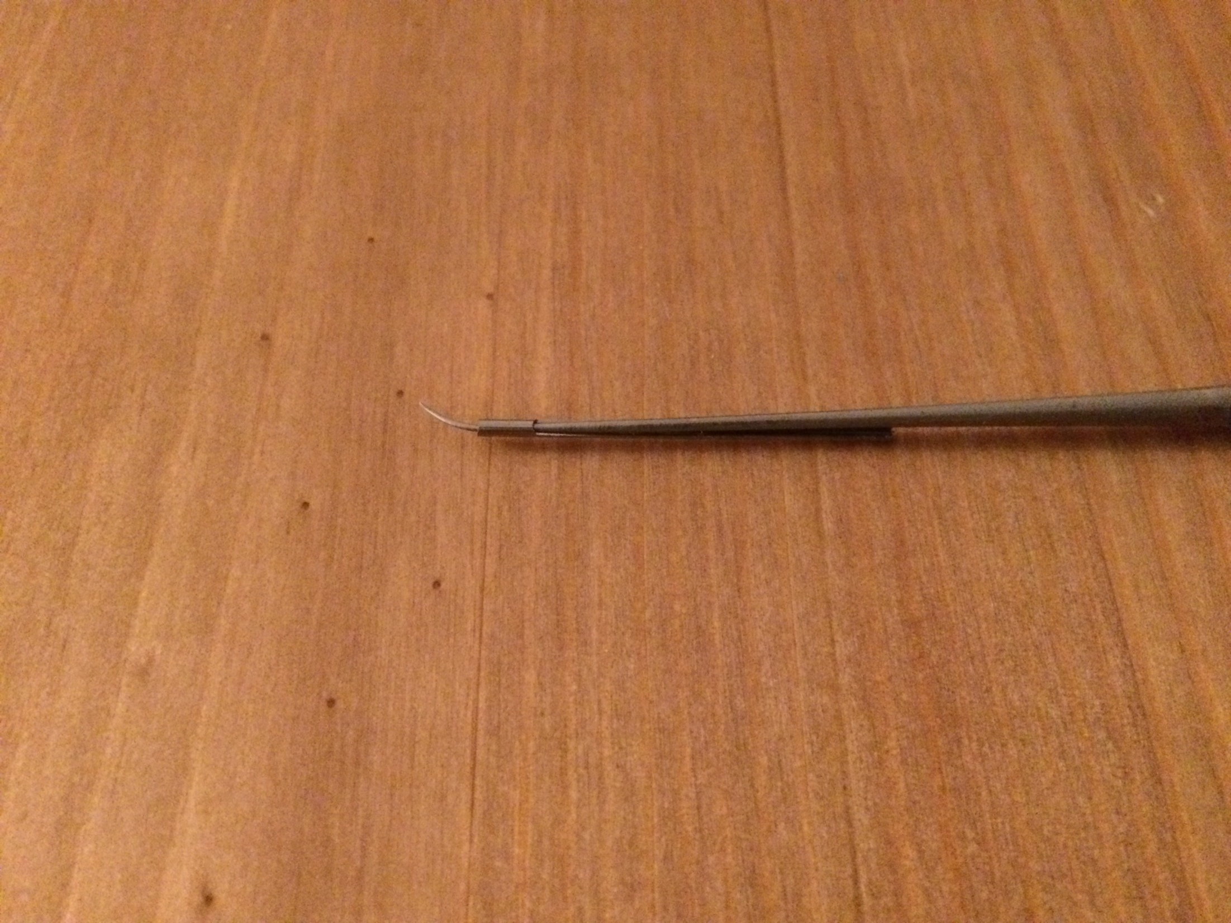
CAD
3D Print
Test

Slide 6
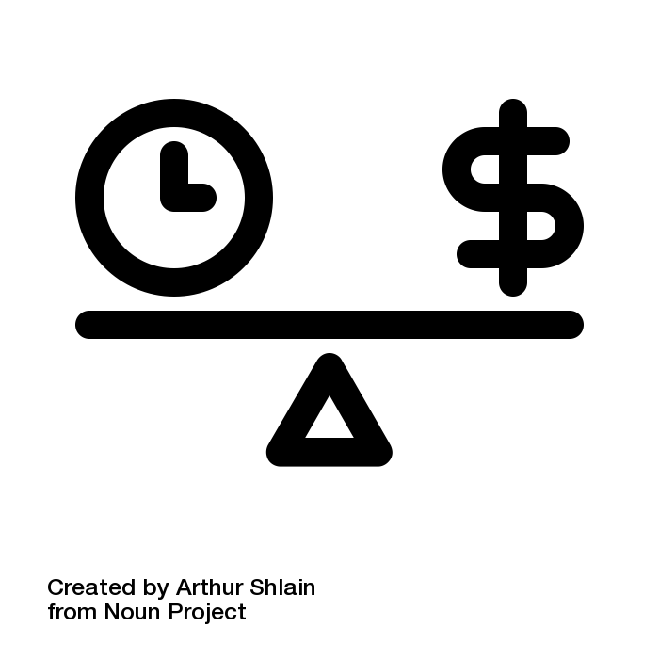
Realize and design for
X
Constraints
= TIME AND MONEY
Modification of tool
Used connections/resources currently available at SickKids and U of T
Asked for advice – TA, Dr. Andrysek and Dr. Forte
Notes:
Realize and design for you constraints
Medical device development requires time and money which you do not have so…. We made a modification to an existing tool instead of reinventing the wheel

Slide 7
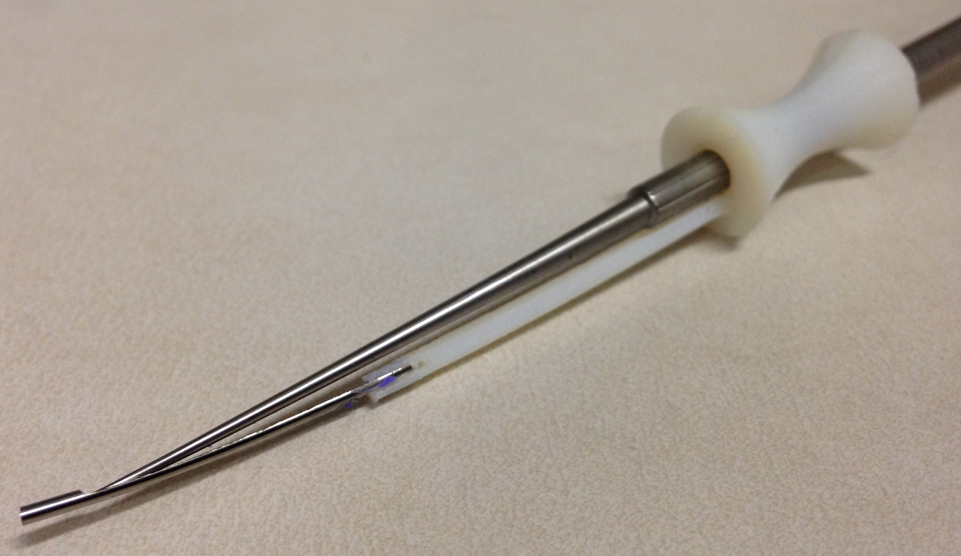
Final Design
CAD
Simple Prototype
More mechanisms

Slide 8
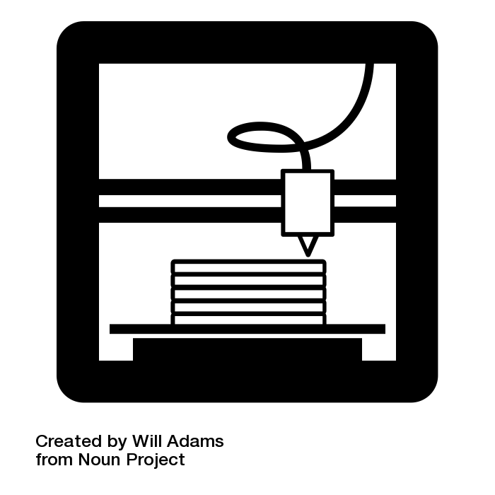
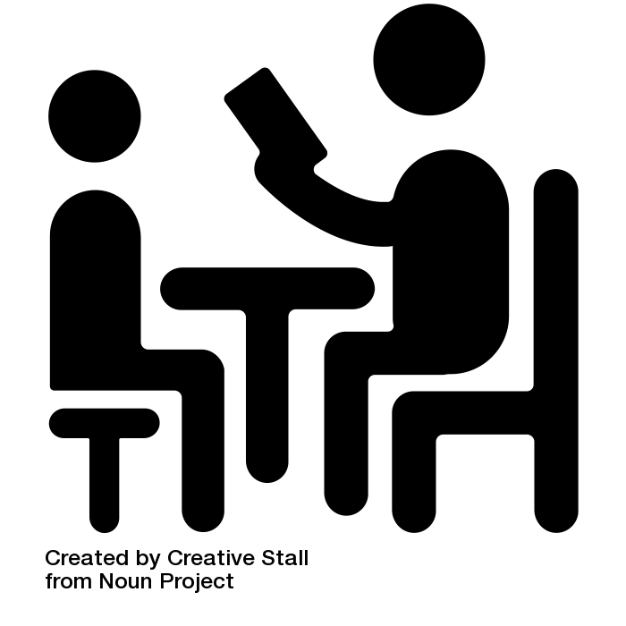
Design Studio
Client & Teaching Team
Meeting space, collaboration, prototyping, technical help

